Slide 2
Occupational and Environmental Health Nursing
Board Certification

Slide 3
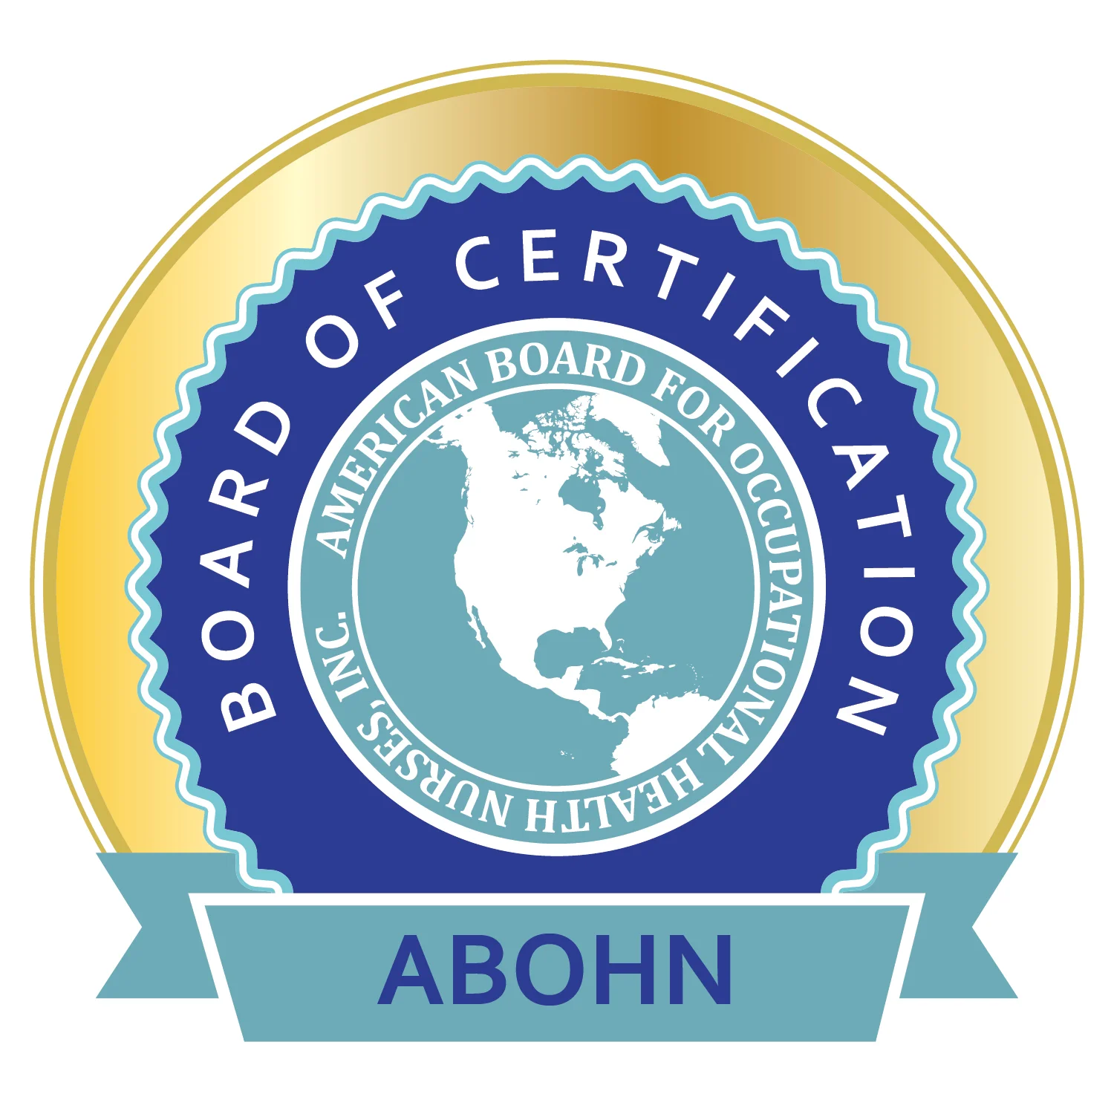
American Board for Occupational Health Nurses (ABOHN)
ABOHN is the sole certifying body for occupational health nurses in the U.S.

Slide 4
Three Core Credentials – COHN, COHN-S, CM
Apply for exam based on your role and experience (not just degree type)
Certified Occupational Health Nurse (COHN)
  More clinical focus
    Must hold an active RN license or international equivalent
    Must have 3,000 hours of OHN work experience completed in the past 5 years
Certified Occupational Health Nurse-Specialist (COHN-S)
  More management/administrative focus
    Must have a Bachelor Degree or higher (does not need to be in Nursing)
    Must hold an active RN license or international equivalent
    Must have 3,000 hours of OHN work experience completed in the past 5 years

Slide 5
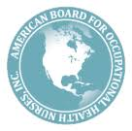
Additional Specialty Credential
  Case Management (CM)
    Must hold a core credential
    Must hold RN license or international equivalent
    Must have at least 10 contact hours in the past 5 years.
The ABOHN Flyers: Have basic information about the COHN, COHN-S, and CM examinations.
  https://www.abohn.org/sites/default/files/OHNFlyer021723PR.pdf
  https://www.abohn.org/sites/default/files/CMFlyer021723PR.pdf
COHN/COHN-S Certification Handbook
Case Management (CM) Handbook

Slide 6
Occupational Health Nurse Board Certification
For most positions – Certification is not required but highly encouraged.
Available only to RNs and NPs
Importance:
  Demonstrates knowledge and competence
  Specialty expertise
  Mark of prestige
  Demonstrate commitment to lifelong learning
  Sign of excellence
  Personal and professional accomplishment
www.abohn.org
Notes:
Let’s discuss the Certification in Occupational and Environmental Health Nursing.
The certification is a voluntary process reflecting the proficiency in the nursing field.
For most positions, the certification is not required, but highly encouraged, and it is only available to RNs and NPs.
What is the importance or some of the benefits to be board certified?
In addition to the ones presented on this slide, we can mention:
That it leads to career advancement opportunities
Employers use the certification to make employment decisions
It demonstrates the commitment to worker health and safety
It provides with networking opportunities
Sometimes it leads to an increase in pay and promotions.
It demonstrates professionalism and proficiency to your organization and to the general public.
Retrieved from www.abohn.org

Slide 7
Certification - Requirements
Recertification:
  Five-year cycle
  Active Licensure as an RN, or an international equivalent.
  3,000 hours of occupational health nursing practice (work experience)
  50 Continuing Nursing Education (CNE) contact hours related to occupational health practice
  CM – 10 Continuing Nursing Education (CNE) contact hours related to Case Management
Notes:
Initial Certification: read slide
Recertification
To maintain "Active" COHN/COHN-S and CM statuses, recertification is required every 5 years.
Recertification eligibility criteria includes:
•Active licensure as a registered nurse (RN), or an international equivalent:
•3,000 hours of occupational health nursing practice (work experience); and
•50 Continuing Nursing Education (CNE) contact hours related to occupational health practice.
Additional recertification requirements for the Case Management credential are:
•10 Continuing Nursing Education (CNE) contact hours related to occupational health case management practice.
As mentioned before, the certification is a voluntary process; not mandatory.
Reference:
ABOHN: Recertification. Retrieved from https://www.abohn.org/maintenance/recertification

Slide 8
ABOHN Certification Examination
Fees:
  Application
  Exam
  Annual ABOHN certification renewal
  5-year recertification
To achieve COHN and COHN-S certification, eligible candidates must be successful on a 160-question, (135 scored and 25 pre-test) multiple choice, computer-based examination.
Candidates have three hours to complete the examination.

Slide 9
ABOHN Certification Exam – Getting Ready!
ABOHN - Certification Self Assessment Tests (CSATs)
  Practice Test – 100 questions (PDF format)
American Association of Occupational Health Nurses (AAOHN)
  Review Courses: Virtual on Zoom - Upcoming review courses posted here
About the AAOHN course:
  COHN/COHN-S aligns with the ABOHN Exam Outline and covers all key areas of occupational health nursing.
  This live event offers 16 contact hours.
  Attendees will receive 4 days of instruction from our COHN/COHN-S certified course instructors, as well as attendee resources for further study.
  AAOHN also offers additional add-on COHN/COHN-S resources for purchase with the course package.
  Participants will assess their current knowledge, sharpen test-taking skills, and gain a clear path to develop a study plan—all while engaging in interactive group activities, pre- and post-tests, and real-world case studies.

Slide 10
ABOHN Certification Exam – Getting Ready!
AAOHN: COHN/COHN-S Online Certification Review Course
  Offered entirely in an online format
  Self-paced to accommodate the learner's needs
  There is not a printable guide to accompany the course modules
  Accessible in the AAOHN Online Education Center
  Additional resource material is offered in various sections as handouts
  Includes 18 modules with knowledge check questions and additional resources for study
  Up to 16 CNE upon successful completion

Slide 11
ABOHN Certification Exam – Getting Ready!
AAOHN: COHN/COHN-S Pop-Up Quiz
  Questions in each of six categories
  80% minimum passing score required to complete the quiz
  Learners may restart the quiz as needed for multiple attempts
  Use it as a final review to test your knowledge before sitting for the certification exam.
  Two (2) CNE hours

Slide 12
ABOHN Certification Exam – Getting Ready!
AAOHN: Additional resources
  Fundamentals of Occupational and Environmental Health Nursing, The 5th Edition Core Curriculum:
    Hardcopy
    PDF

Slide 13
COHN/COHN-S Review Courses – List is Not Exhaustive!
ABOHN: https://www.abohn.org/
AAOHN: https://www.aaohn.org/
Annette B. Haag and Associates: https://www.annettehaag.com/
Johns Hopkins Bloomberg School of Public Health:
https://publichealth.jhu.edu/johns-hopkins-education-and-research-center-for-occupational-safety-and-health/continuing-education/upcoming-continuing-education-courses/overview-of-occupational-health-nursing-online-course
Colorado School of Public Health: https://chwe.learningcart.com/content/Occupational-Health-Nursing-Training.aspx

Slide 14
Summary
ABOHN is a separate and independent specialty certification board that evaluates the qualifications of candidates who voluntarily seek certification.
AAOHN is the professional membership association of registered nurses engaged in the specialty of occupational health nursing.
ABOHN uses the definitions and standards of practice promulgated by AAOHN to set the criteria and standards for certification.
Membership in AAOHN is not required for certification, but it is encouraged in order to maximize your access to certification resources.
Board certification is highly encouraged!

Slide 15

QUESTIONS
Email: education@aaohn.org
Call: (312)-321-5173

